Slide 1
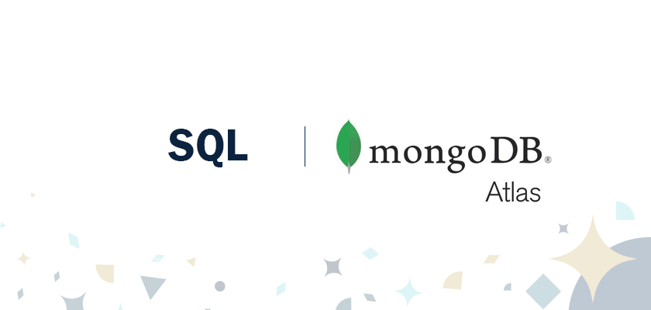


vs

Slide 2


Intro to MongoDB & SQL
MongoDB :
1
It’s an open-source, NoSQL document database. It is popularly used in conjunction with Amazon Web Services, Azure, and other data sources for application development and ongoing operation.
In simple terms, MongoDB is a document-oriented database. This open-source product is developed and supported by 10gen.
SQL :
2
For the deployment of Cloud applications, SQL Databases are typically used as Relational Databases. In addition to high-performance analytics, they provide various features for accessing, adding, managing, and processing data. It is a Database System that is easy to use, contains robust classification features, and offers uncomplicated reliability.

Slide 3
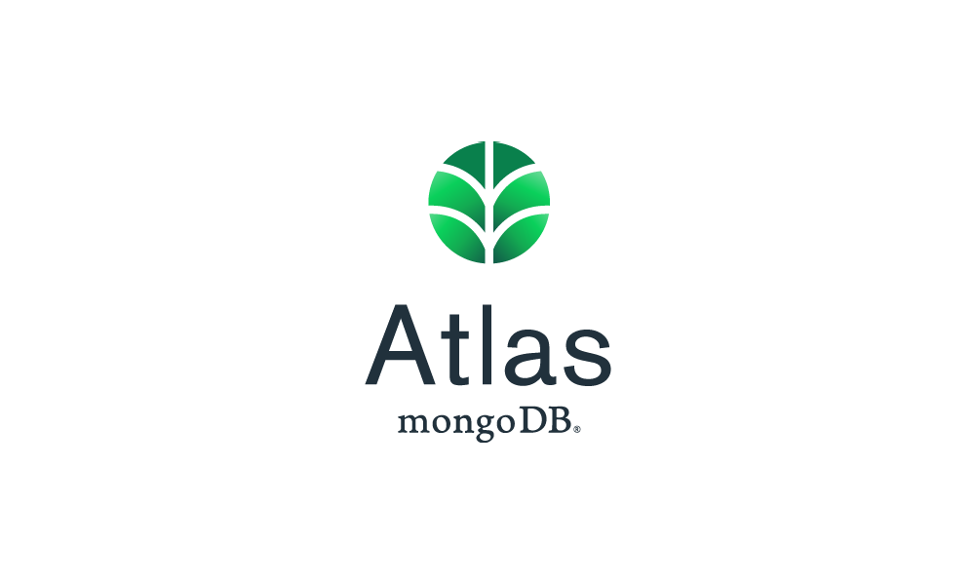

History of MongoDB & SQL
MongoDB :
1
Mongo DB was initially developed in 2007 as the company worked on a platform as a service similar to Microsoft Azure.
Mongo DB was created by 10gen, an organization headquartered in New York known as Mongo DB Inc. The platform was initially designed as a PAAS (Platform as a Service). Towards the end of 2009, Mongo DB Inc. introduced it in the market as an open-source database server.
SQL :
2
The great computer scientist “E.F. Codd” published “A Relational Model of Data for Large Shared Data Banks” in 1970.
To create the SEQUEL (Structured English Query Language), IBM researchers Raymond Boyce and Donald Chamberlin learned about it in an E.F. Codd paper. It was at IBM Corporation’s San Jose Research Laboratory that they developed SQL in 1970.

Slide 4
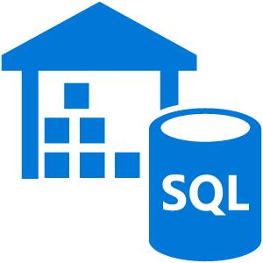
Features of MongoDB & SQL
MongoDB :
SQL :
1
There are the following features of MongoDB:
There are multiple search options in MongoDB, including field, range, and regular expression categories.
Any area can index documents.
A load balancing configuration is automatically implemented because the data is split into shards.
It provides tools for map reduction and aggregation.
The code is written in JavaScript instead of Procedures
2
In general, SQL functions offer many features.
A SQL operation can easily be implemented using SQL procedural language statements and features, which allow you to integrate control-flow logic into conventional static and dynamic SQL statements.
A SQL function is usually more reliable than an equivalent external function.
Provide input parameters.
Scalar SQL functions return numerical values.
Provide a powerful but straightforward model for handling conditions and errors.

Slide 5
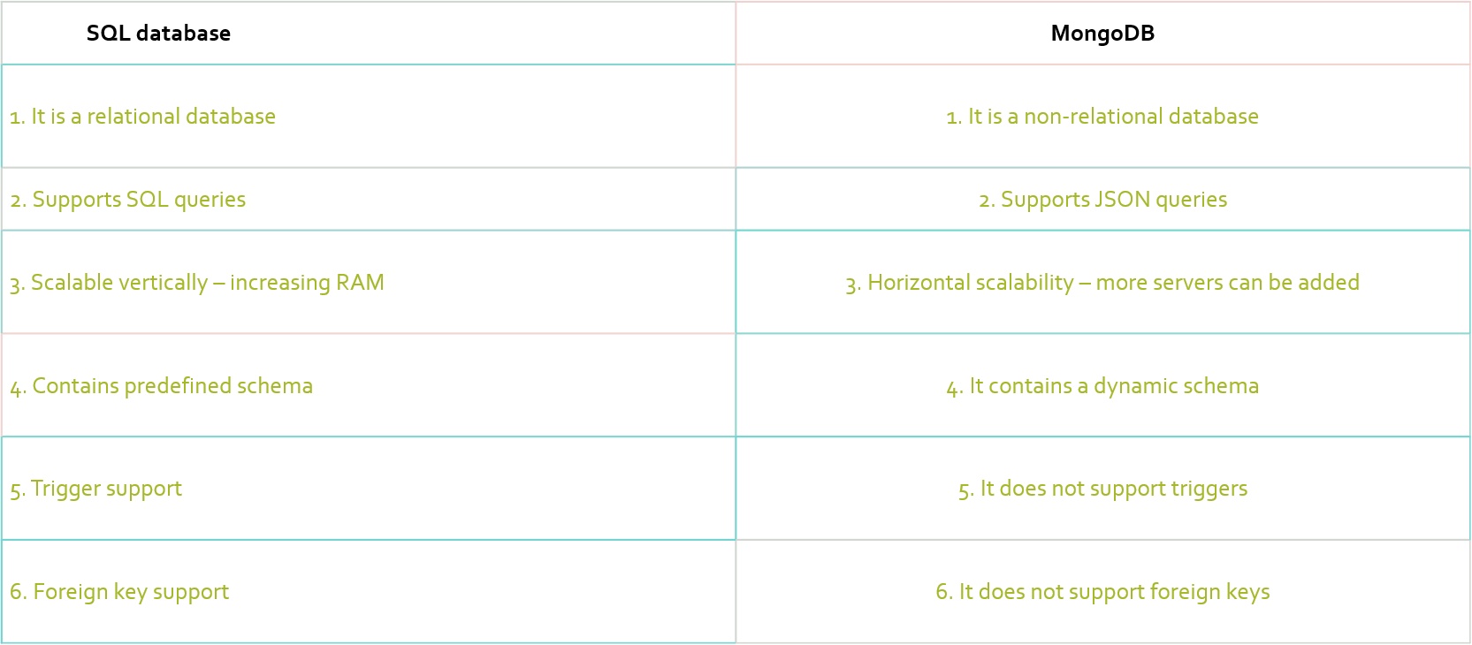
SQL vs MongoDB: key differences

